Slide 1





LSDTopoTools: reproducible topographic analysis
Stuart Grieve, Fiona Clubb, Boris Gailleton, Martin Hurst, Declan Valters & Simon Mudd

Slide 2
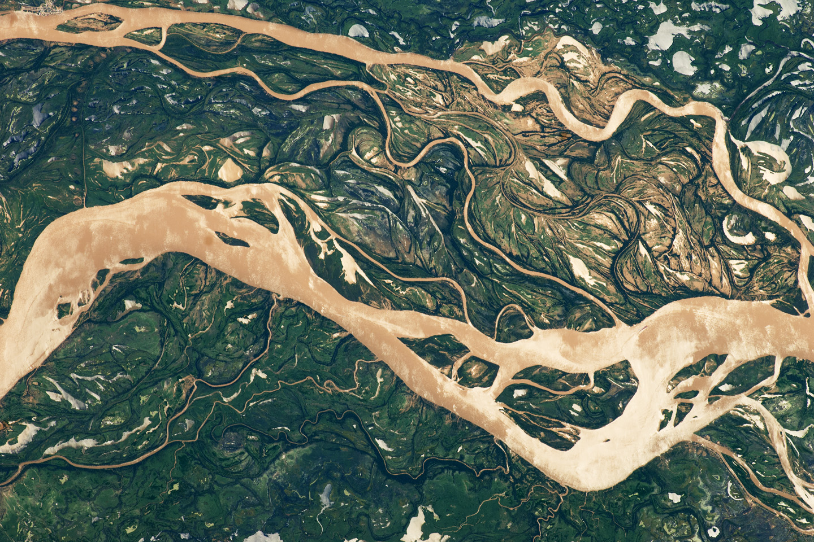

What is our software?
Not a GIS!
Set of topographic analysis routines, written in C++
Designed to implement latest developments in topographic analysis
Supports numerical modelling of landscape evolution
To enable reproducible topographic analysis and the sharing of workflows

Slide 3
Today’s workshop
Channel network extraction
Generating slope and curvature
Channel steepness analysis

Slide 4
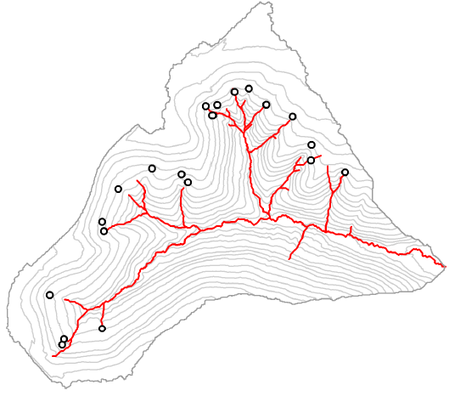
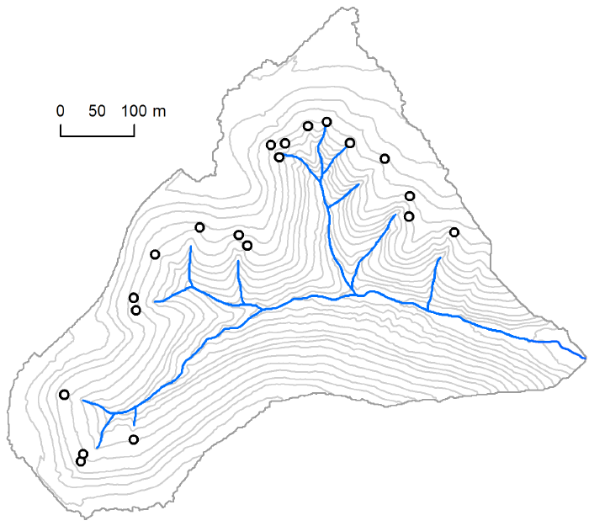
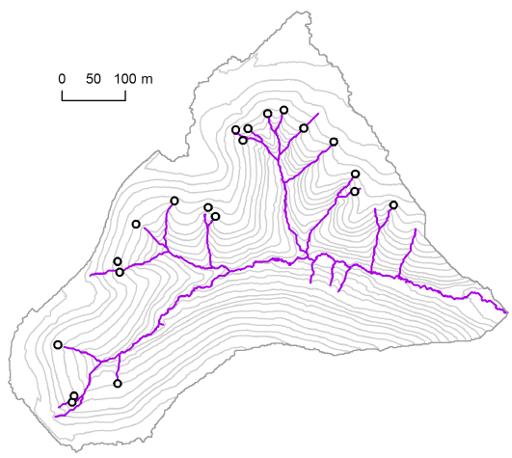
1. Channel network extraction
Several different channel extraction methods:
Area thresholds
Geometric-based methods (curvature)
Process-based methods (DrEICH algorithm)
Clubb et al. (2014) WRR

Slide 5
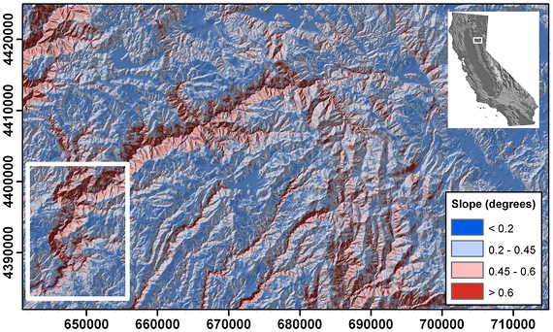
2. Generating slope and curvature
Hurst et al. (2012) JGR

Slide 6
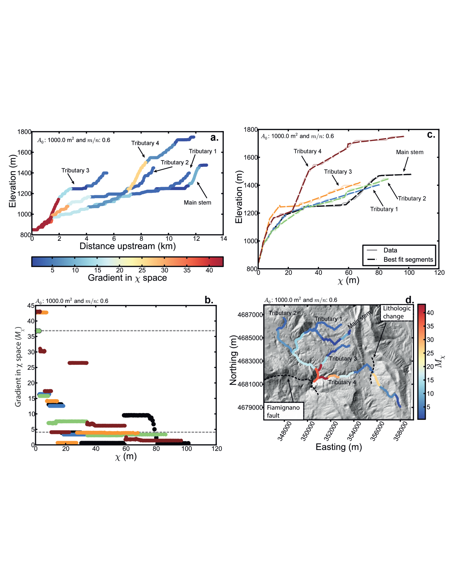
3. Channel steepness analysis
Rio Torto, Apennines, Italy
Mudd et al. (2014) JGR-ES

Slide 7
Want to learn more or collaborate?
Check out our full documentation:
https://lsdtopotools.github.io/LSDTT_documentation/
Chat with us during EGU!
Send us an email or tweet:
Stuart s.grieve@qmul.ac.uk @GIStuart
Fiona clubb@uni-potsdam.de @FionaClubb25
Boris s1675537@sms.ed.ac.uk @boris_gailleton
@LSDTopoTools

